Slide 1
Contents
Introduction and Motivation
Biological neuron vs. Artificial Neuron
When to use neural networks
Single Node Perceptron
Perceptron Example
Multi-layer Perceptron
Activation Functions
Optimizers

Slide 2
Neural Networks
A machine learning approach inspired by the way in which the brain performs a particular learning task
Knowledge about the learning task is given in the form of examples
Inter neuron(node) connection strengths (weights) are used to store the acquired information (the training examples)
Weights are modified during the learning process in order to model the particular learning task correctly on the training examples
The model is then used for predicting new task

Slide 3
Neural Networks
Computational models inspired by the human brain:
Massively parallel, distributed system, made up of simple processing units (neurons)
Synaptic connection strengths among neurons are used to store the acquired knowledge.
Knowledge is acquired by the network from its environment through a learning process

Slide 4
Artificial Neural Networks
A neural network is a massively parallel, distributed processor made up of simple processing units (artificial neurons).
It resembles the brain in two respects:
Knowledge is acquired by the network from its environment through a learning process
Synaptic connection strengths among neurons are used to store the acquired knowledge.

Slide 5
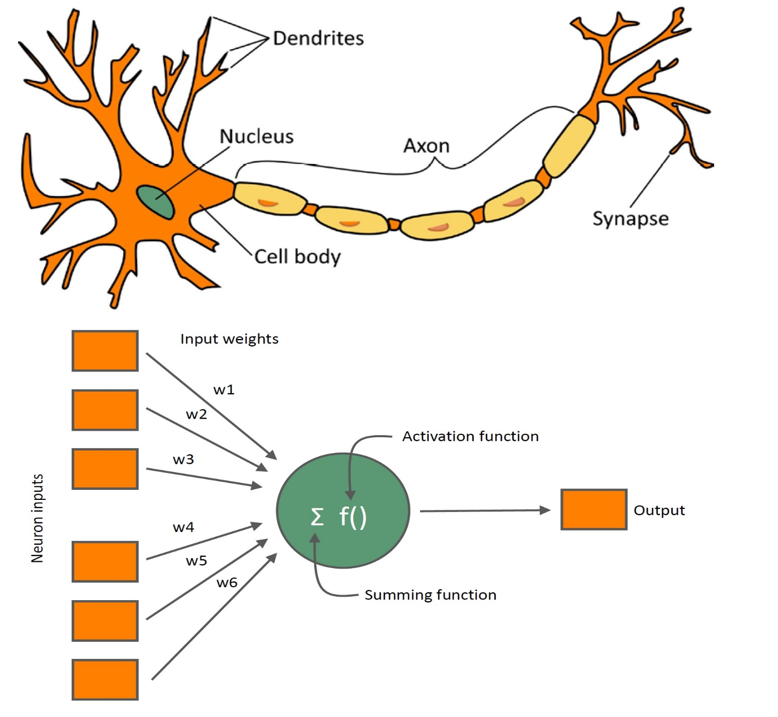
Biological Neuron | Artificial Neuron
Cell Body with Nucleus or soma | Node
Synapse | Weights or Interconnections
Dendrites | Input
Axons | Output

Slide 6
Properties of ANNs
Learning from examples
labeled or unlabeled
Adaptivity
changing the connection strengths to learn things
Non-linearity
the non-linear activation functions are essential
Fault tolerance
if one of the neurons or connections is damaged, the whole network still works quite well
Thus, they might be better alternatives than classical solutions for problems characterised by:
high dimensionality, noisy, imprecise or imperfect data; and
a lack of a clearly stated mathematical solution or algorithm

Slide 7

Different Network Topologies
Single layer feed-forward networks
– Input layer projecting into the output layer
Input layer
Output layer

Slide 8
Different Network Topologies
Multi-layer feed-forward networks
One or more hidden layers.
Input projects only from previous layers onto a layer.
typically, only from one layer to the next
2-layer or
1-hidden layer fully connected network
Input layer
Hidden layer
Output layer

Slide 9
Different Network Topologies
Recurrent networks
– A network with feedback, where some of its inputs are connected to some of its outputs (discrete time).
Input layer
Output layer

Slide 10
Applications of ANNs
ANNs have been widely used in various domains for:
Pattern recognition
Function approximation
Associative memory
– ...

Slide 11
Artificial Neural Networks
Early ANN Models:
Perceptron, ADALINE, Hopfield Network
Current Models:
Deep Learning Architectures
Multilayer feedforward networks (Multilayer perceptrons)
Radial Basis Function networks
Self Organizing Networks
– ...

Slide 12
How to Decide on a Network Topology?
# of input nodes?
Number of features
# of output nodes?
Suitable to encode the output representation
transfer function?
Suitable to the problem
# of hidden nodes?
Not exactly known

Slide 13
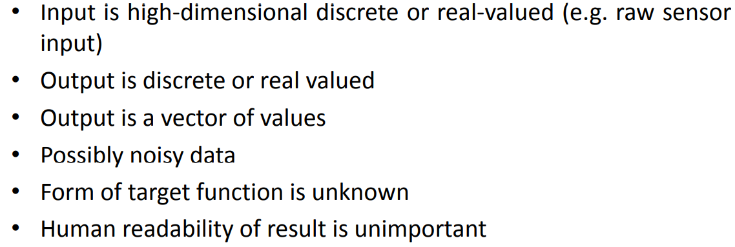
When to use Neural Network

Slide 14
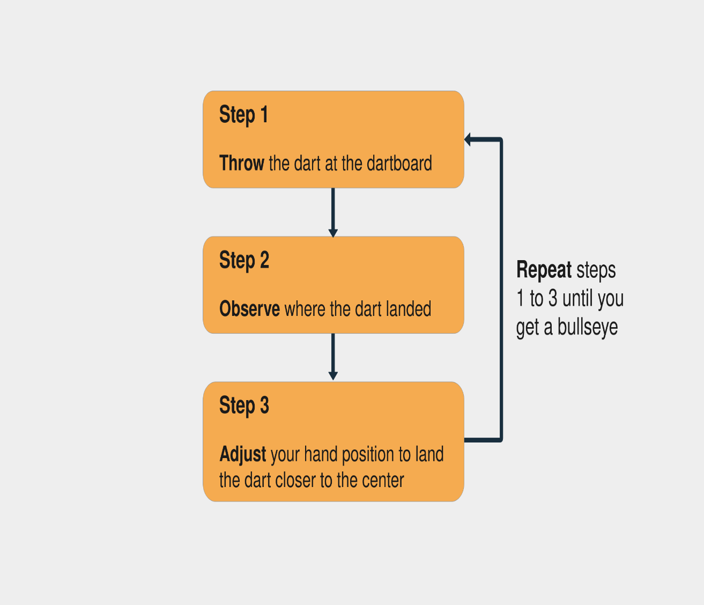
Neural Network
A neural network is a system that learns how to make predictions by following these steps:
Taking the input data
Making a prediction
Comparing the prediction to the desired output
Adjusting its internal state to predict correctly the next time

Slide 15
Neural Network
An architecture:
A set of neurons and links connecting neurons. Each link has a weight,
A neuron model:
The information processing unit of the NN,
a learning algorithm:
used for training the NN by modifying the weights in order to solve the particular learning task correctly on the set of training examples.

Slide 16



Perceptron Model
Bias
x₁
w₁
Activation
function
Input
signal
x₂
w₂
Summing
function
x_{n}
w_{n}
Synaptic
weights
Output (y`) = 1 if Wx+b > 0
0 if Wx+b ≤ 0

Slide 17
Working of Perceptron

Slide 18
Steps Involved in Learning
Initialize weight values and bias
Forward Propagate
Check the error
Backpropagate and Adjust weights and bias
Repeat for all training examples

Slide 19
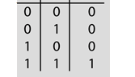
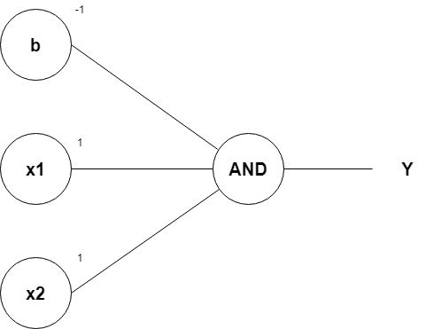
Perceptron - Example
Row 1
Passing the first row of the AND logic table (x1=0, x2=0), we get;
0+0–1 = –1
From the Perceptron rule, if Wx+b≤0, then y`=0. Therefore, this row is correct, and no need for Backpropagation.
Row 2
Passing (x1=0 and x2=1), we get;
0+1–1 = 0
From the Perceptron rule, if Wx+b≤0, then y`=0. This row is correct, as the output is 0 for the AND gate.
From the Perceptron rule, this works (for both row 1, row 2 and 3).
Row 4
Passing (x1=1 and x2=1), we get;
1+1–1 = 1
Again, from the perceptron rule, this is still valid.
Therefore, we can conclude that the model to achieve an AND gate, using the Perceptron algorithm is;
x1+x2–1
Given
Inputdata x1 x2 Y
Activation function h(x) = 1 if x>0;
0 otherwise
Weights w1=w2=1
Bias=-1
x1(1)+x2(1)–1

Slide 20




Perceptron
OR, AND and NOT are linearly separable
XOR is not linearly separable

Slide 21
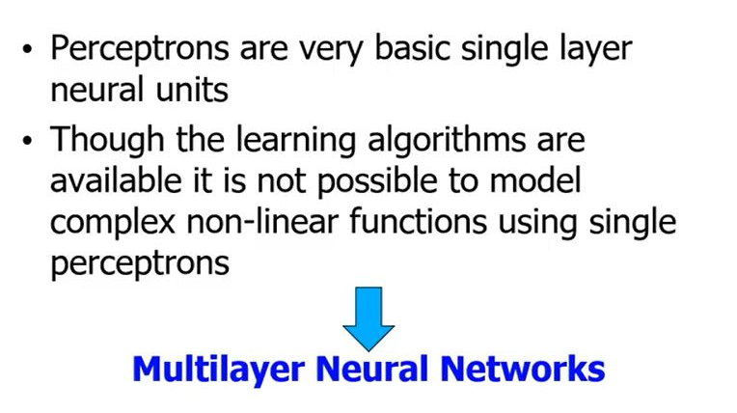
Why Multilayer Networks?

Slide 22
Multilayer Perceptron
Each layer may have different number of nodes and different activation functions
But commonly:
Same activation function within one layer
sigmoid/tanh activation function is used in the hidden units, and
sigmoid/tanh or linear activation functions are used in the output units depending on the problem (classification-sigmoid/tanh or function approximation- linear)

Slide 23
Multi-Layer Feed forward
Input
layer
Output
layer
Hidden Layer

Slide 24
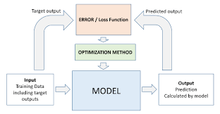
Multi-Layer Feed forward-Learning

Slide 25
Activation Function
Mathematical function that determine the output of a neuron
Linear Activation Function
Binary step function
Non-linear Activation Functions
Sigmoid,
Tanh
ReLu
LeakyRelu
Softmax etc.,
Bias
x₁
w₁
Activation
function
Input
signal
x₂
w₂
Summing
function
x_{n}
w_{n}
Synaptic
weights

Slide 26
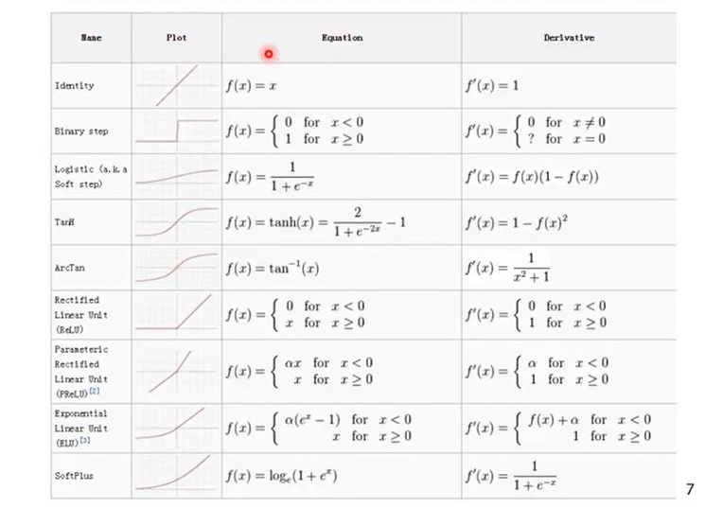
Activation Function(contd…)

Slide 27
Choosing the right functions
Problem type | Last-layer activation | Loss
Binary Classification | sigmoid | binary_crossentropy
Multiclass,Single-label Classification | Softmax | Categorical_crossentropy
Multiclass,Multi-label Classification | sigmoid | binary_crossentropy
Regression to arbitrary values | None | mse
Regression to values between 0 and 1 | sigmoid | mse or binary_crossentropy

Slide 28
Optimizers
Types of Optimizers are:
Adam
RMSprop
SGD
Adadelta
Adagrad
Adamax

